Slide 1
DAIBETES PREDICTION USING MACHINE LEARNING
PRESENTED BY
NIKHIL V. REDEKAR

Slide 2
INTRODUCTION
Diabetes is a disease which is rapidly increasing all over the world and it is a most common disease caused by a group of metabolic disorders. It occurs when pancreas does not produce sufficient insulin, or body can not sufficiently use insulin it produces. Diabetes person has increase blood glucose in the body. One of the major problem diabetic patients suffers from is the diabetic retinopathy (DR) and blindness. Since the number of diabetes patients is continuously increasing, it increases the data as well.

Slide 3
PROMBLEM STATEMENT
Diabetes is the most common disease caused by a group of metabolic disorders. It can be controlled by predicting this earlier. Now a days, healthcare industries are generating a large volume of data and by applying various machine learning techniques we can predict early signs of diabetes also it helps doctors to diagnose the patient.

Slide 4
OBJECTIVE
The objective aims to analyze the Diabetes dataset, design, and implement a Diabetes prediction system utilizing machine learning classification techniques. The specific objectives of this project work are:
Design and Develop a model using machine learning techniques.
To analyze the Diabetes dataset and use Support Vector Machine, Random forest, Logistic Regression, Decision Tree, K Nearest Neighbours, Gradient Boosting and Ada Boosting algorithms to develop a prediction engine.

Slide 5
METHODOLOGY
Dataset collection
EDA (Exploratory Data Analysis)
Feature Engineering
Feature Scaling
Splitting Data into training and testing set
Applying Machine Learning Algorithms for Model building
Model Evaluation
Model Optimization

Slide 6
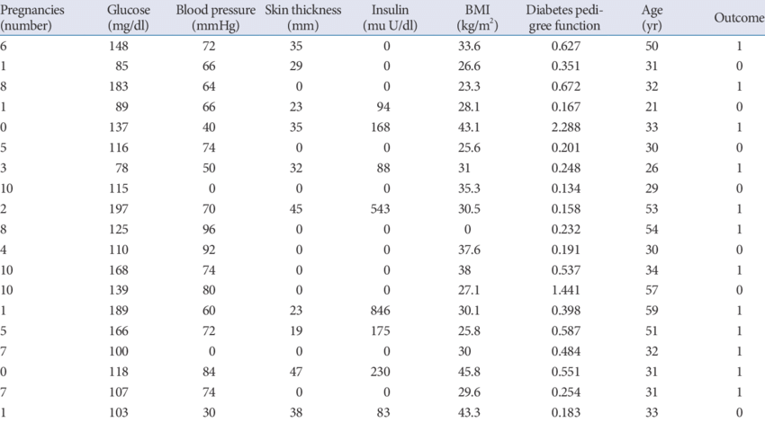
DATASET

Slide 7
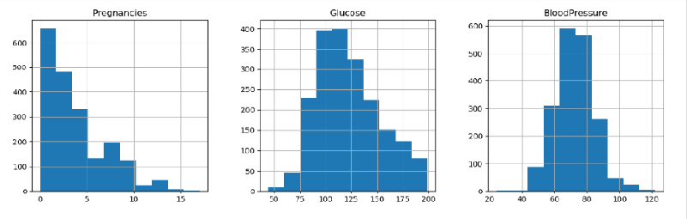
EXPLORATORY DATA ANALYSIS
Data Cleaning
Data Visualization
Selecting Statistical methods

Slide 8
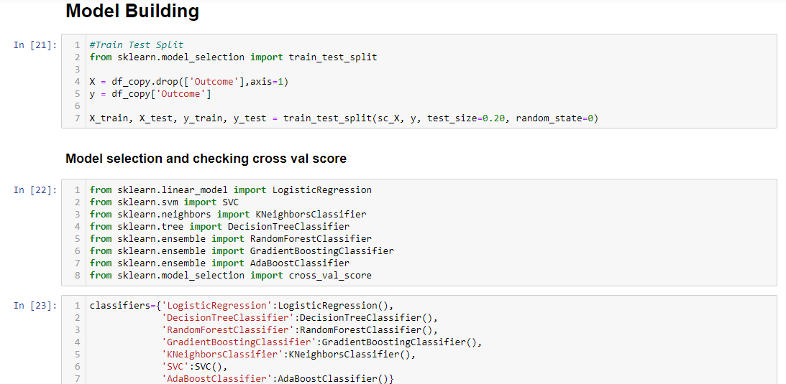
MODEL BUILDING

Slide 9
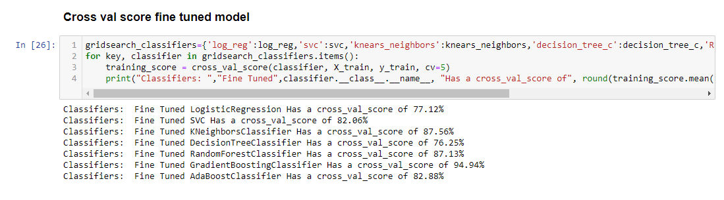
ACCURACY USING CROSS VAL SCORE

Slide 10
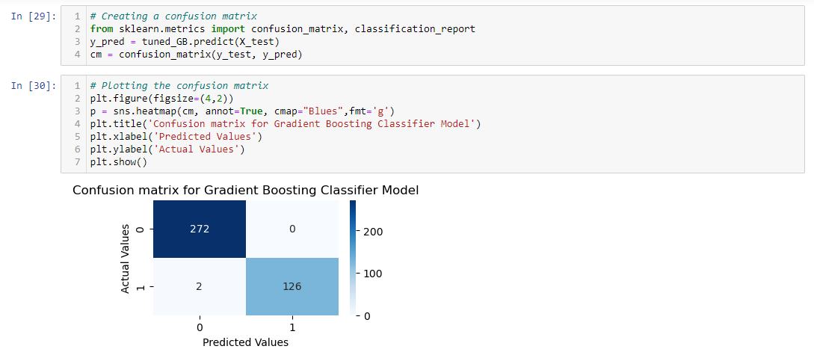
MODEL EVALUATION

Slide 11
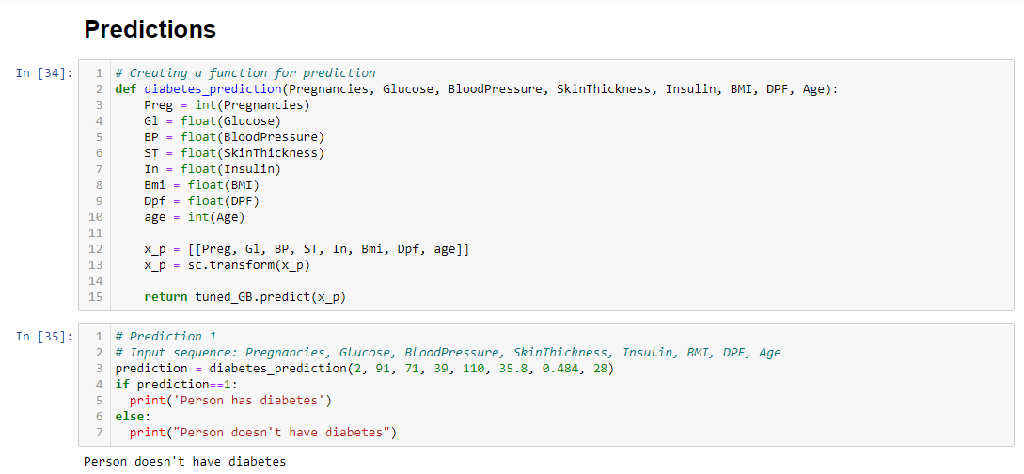
PREDICTIONS

Slide 12
CONCLUSION
We can conclude that among all the algorithms gradient boosting has the score of 87 % using cross validation so we further tune the model using hyperparameter optimization and it gives a score of 94.94%.

Slide 13
THANK YOU

